Slide 1
Annotation:
Why in the world should I?

Slide 2

Benefit #1 of annotation: helps you to stay awake
We all know that sometimes the reading selections can be a tad bit boring right…….
Annotating the text keeps your brain working and it keeps you engaged.
Keeps you from PRETENDING to read aka FAKE READING SYNDROME

Slide 3
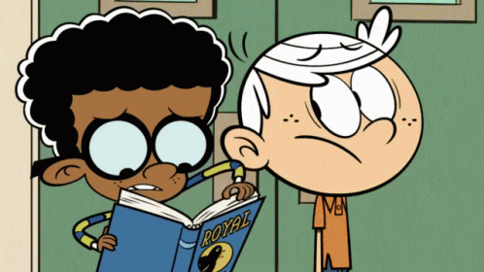
BENEFIT #2 OF ANNOTATION:
Reduces the need to search repeatedly through the text
When you briefly annotate while reading, it gives you “checkpoints” regarding when an event or important part of the selection took place.
Think about how much easier it is to fill out a graphic organizer of what you read when you have already noted important parts of the reading selection.

Slide 4

Benefit #3 of Annotation:
Helps with processing the text
Processing the text includes but is not limited to:
  Predicting/Making inferences
  Working out (decoding) unfamiliar words
  Paraphrasing the text
  Drawing conclusions
  Questioning (yes asking questions is a part of annotating ☺ )
  Summarizing/Paraphrasing the text

Slide 5

TIPS TO REMEMBER WHEN ANNOTATING
Circle any unfamiliar words
Put a question mark near anything that you don’t quite understand or things that are unclear
Put a star or asterisk near important information
Put an exclamation point near turning events
Underline characters names

